Slide 1
Identifying new expansion opportunities for NY based Patsy's pizzeria
Coursera Capstone Project
Farukh Zaripov
March 11, 2919

Slide 2
Agenda
Helping Parcy’s Pizzeria to expand to new locations
Data Acquisition
Analytic Approach
ML Findings
Recommendations

Slide 3
Helping Parcy’s Pizzeria to expand to new locations
Since its origination in 1933, Patsy’s was able to build a loyal client base and became a regular hang out place for many celebrities including Frank Sinatra, Dean Martin and Tony Bennett.
Despite its popularity, Patsy’s still operates at a single location at
2287 First Avenue New York, NY 10035.
The ML model will allow comparing various neighborhoods (on zip code level) based on common sets of features and recommend the best match to current successful location.

Slide 4
Data Acquisition
Data sources that are used for feature engineering
Lat/long for all US zip codes (https://gist.github.com/erichurst/7882666)
The data was used primarily to generate a map with the recommended new locations.
Database of active US businesses based on zip codes. (https://www2.census.gov/programs-surveys/cbp/datasets/2016/zbp16detail.zip?#)
The file provides a breakdown of US businesses by zip code based on number of employees
IRS tax return for every US zip codes (https://www.irs.gov/statistics/soi-tax-stats-individual-income-tax-statistics-2016-zip-code-data-soi).
The file provides number of returns, which approximates the number of households and groups total tax returns into the following bins based on the income.
The data from all sources was combined, merged and aggregated into one file with 19 columns

Slide 5
Analytic Approach
Hierarchical Clustering was used to identify similarities between different geo locations and place them into appropriate clusters.
Advantages it provides for this particular case:
No need to worry about identifying clusters and let the model to do the job
It allows visualizing the distances between different zip codes and helps to immediately identify the closest zip codes to the original location based on their feature similarities.

Slide 6
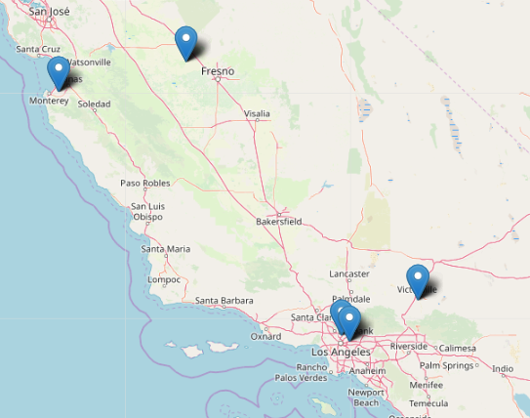
ML findings
The same ML model was used three times against decreasing subset of data. After each run, I would focus on the cluster that contain the actual NY location and run it again for the subset of the data.
The final cluster contained only 6 members including original location and five new potential locations.

Slide 7
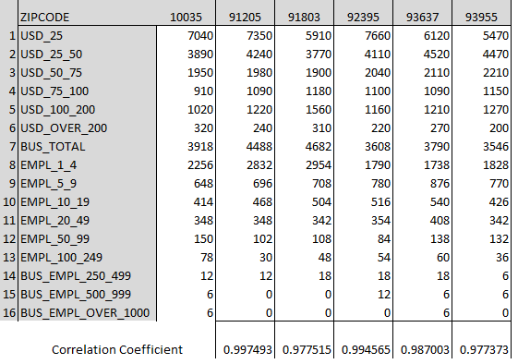
ML findings (continued)
The model produced result that greatly correlates to the existing location patterns.

Slide 8
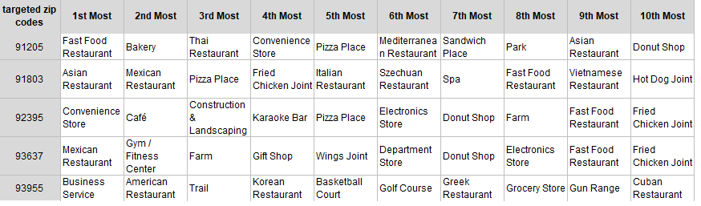
Recommendations
Additional analysis using FourSquare produced the table below with top 10 venues per each new location.
As per the table above, every one of the new locations seem to be very accepting of the diverse world cuisine.
Strong feature correlation and FourSquare based findings provide strong reasons to believe that Patcy’s pizzeria has a great chance of succeeding at any of the five new locations.

